Slide 1
Predictive Modeling
Chapter 8: Regression Trees and Rule-Based Models
STA 6543
The University of Texas at San Antonio

Slide 2
Overview
Part I: General Strategies
Part II: Regression Models
Chapter 6: Linear Regression and Its Cousins
Chapter 7: Nonlinear Regression Models
Chapter 8: Regression Trees and Rule-Based Models
Part III: Classification Models
Chapter 12: Discriminant Analysis and Other Linear Classification Models
Chapter 13: Nonlinear Classification Models
Chapter 14: Classification Trees and Rule-Based Models

Slide 3
Tree-based regression models
A motivating example about the baseball player salary data
Various types of tree-based models
Basic tree-based models (e.g., single trees, model trees)
Bagged trees
Random forest
Boosted trees
Cubist
R demonstrations for solubility data

Slide 4
Basic tree-based methods
Chapter 8-Part II Regression Trees and Rule-Based Models

Slide 5
What is tree?

Slide 6
What is tree?

Slide 7
What is tree?

Slide 8
Overview
These involve stratifying or segmenting the predictor space into a number of simple regions.
Tree-based methods are useful for interpretation.
They typically are not competitive with the best supervised learning approaches, such as those seen in Chapters 6 and 7, in terms of prediction accuracy.
To improve prediction accuracy, we introduce bagging, random forests, and boosting, at the expense of some loss in interpretation.
Decision trees can be applied to both regression (Chapter 8) and classification problems (Chapter 14).

Slide 9
A motivating example: baseball player salary data
The Hitters data set is provided in the R package ISLR
We use this data to predict a baseball players Salary based on Years (the number of years that he has played in the major leagues) and Hits (the number of hits that he made in the previous year)

Slide 10
Data preprocessing
Remove observations that are missing Hitters or Salary values.
Log-transform Salary so that its distribution has more of a typical bell-shape.

Slide 11
R code
### Load packages library(AppliedPredictiveModeling) library(caret) library(ISLR) #access the Hitters data library(tree) #### Example: Baseball Player Salary Data (Hitters) Hitters1 = na.omit(Hitters) par(mfrow=c(1,2)) hist(Hitters1$Salary,prob=T, main="Salary") hist(log(Hitters1$Salary),prob=T, main="log(Salary)", col=2) dev.off() sal.tree = tree(log(Salary) ~ Years + Hits, data = Hitters1) sal.tree3 = prune.tree(sal.tree, best=3) #the number of terminal nodes is 3 plot(sal.tree3) text(sal.tree3, pretty=0) title("Baseball Player Salary Data")

Slide 12
A motivating example: baseball player salary data
We want to predict a baseball player’s Salary based on Years and Hits. Here log-transform is applied to Salary.

Slide 13
Regression trees: baseball example
The regression tree is easy to interpret and has a nice graphical representation.
Years is the most important factor in determining Salary, and players with less experience earn lower salaries than more experienced players.
Given that a player is less experienced, the number of Hits that he made in the previous year seems to play little role in his Salary.
But among players who have been in the major leagues for five or more years, the number of Hits made in the previous year does affect Salary, and players who made more Hits last year tend to have higher salaries.

Slide 14
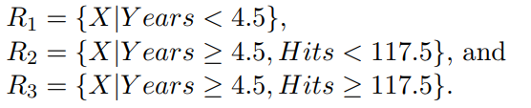
The three-region partition
The tree stratifies the players into three regions:

Slide 15
R code
#The three-region partition rbPal <- colorRampPalette(c('red','green')) Hitters1$Col <- rbPal(20)[as.numeric(cut(log(Hitters1$Salary), breaks = 10))] plot(Hitters1$Years,Hitters1$Hits,pch = 15, xlab = "Years", ylab = "Hits", col = Hitters1$Col) partition.tree(sal.tree3,add=T, cex = 1.2, col = "blue")

Slide 16
Building a regression tree
We divide the predictor space—that is, the set of possible values for X₁, X₂, . . . , X_{p}—into J distinct and non-overlapping regions, R₁, R₂, ..., R_{J} .
For every observation that falls into the region R_{j}, we make the same prediction, which is simply the mean of the response values for the training observations in R_{j}.
In theory, the regions could have any shape. However, we choose to divide the predictors into high-dimensional rectangles, or boxes, for simplicity and ease interpretation of the resulting predictive model.

Slide 17
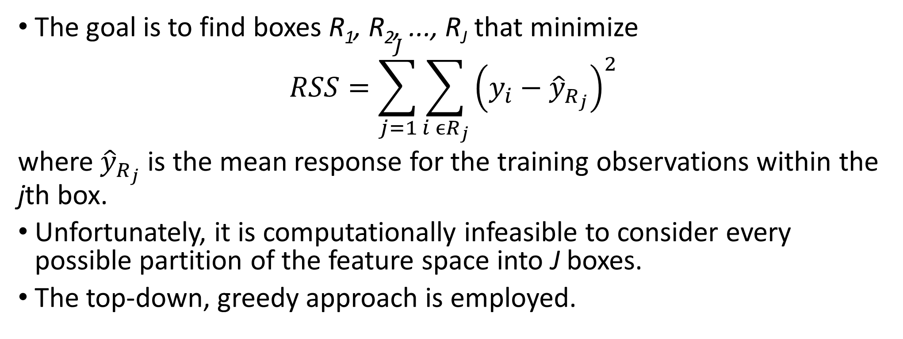
How to construct the regions?
The goal is to find boxes R₁, R₂, ..., R_{J} that minimize
$$RSS=\sum_{j=1}^{J}{\sum_{i ϵR_{j}}{{\left(y_{i}−{\hat{y}}_{R_{j}}\right)}^{2}}}$$
where ${\hat{y}}_{R_{j}}$ is the mean response for the training observations within the jth box.
Unfortunately, it is computationally infeasible to consider every possible partition of the feature space into J boxes.
The top-down, greedy approach is employed.

Slide 18
The top-down, greedy approach
It is known as recursive binary splitting.
The approach is top-down because it begins at the top of the tree and then successively splits the predictor space; each split is indicated via two new branches further down on the tree.
It is greedy because at each step of the tree-building process, the best split is made at that particular step, rather than looking ahead and picking a split that will lead to a better tree in some future step.

Slide 19
Example of regression trees

Slide 20
Example of regression trees

Slide 21
Example of regression trees
When should tree growing be stopped?

Slide 22
Revisit baseball player salary data
> summary(sal.tree)
Regression tree:
tree(formula = log(Salary) ~ Years + Hits, data = Hitters1)
Number of terminal nodes: 8
Residual mean deviance: 0.2708 = 69.06 / 255
Distribution of residuals:
Min. 1st Qu. Median Mean 3rd Qu. Max.
-2.2400 -0.2980 -0.0365 0.0000 0.3233 2.1520

Slide 23
Tree pruning
The process described above may produce good predictions on the training set, but is likely to overfit the data, leading to poor test set performance.
A smaller tree with fewer splits (that is, fewer regions R₁, . . . , R_{J} ) might lead to lower variance and better interpretation at the cost of a little bias.
A common strategy to help lower down the number of candidate subtrees is cost–complexity tuning by Breiman et al. (1984) .

Slide 24
Tree pruning

Slide 25
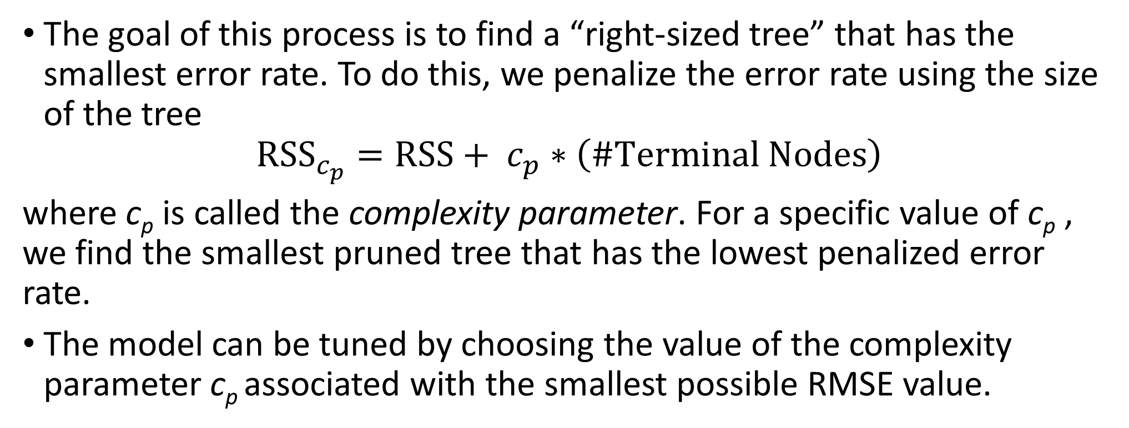
Tree pruning
The goal of this process is to find a “right-sized tree” that has the smallest error rate. To do this, we penalize the error rate using the size of the tree
$${RSS}_{c_{p}}=RSS+ c_{p}∗\left(\#Terminal Nodes\right)$$
where c_{p} is called the complexity parameter. For a specific value of c_{p} , we find the smallest pruned tree that has the lowest penalized error rate.
The model can be tuned by choosing the value of the complexity parameter c_{p} associated with the smallest possible RMSE value.

Slide 26
Cross-validation and pruning
The tree package contains function cv.tree for pruning trees by cross-validation.
The function cv.tree does k-fold cross-validation (default is 10)

Slide 27
Prune the tree using cv.tree
The optimal prune size is 4.

Slide 28
R code
sal.tree = tree(log(Salary) ~ Years + Hits, data = Hitters1) summary(sal.tree) sal.tree plot(sal.tree) text(sal.tree, pretty=0) title("Baseball Player Salary Data") #Pruning a tree by cv set.seed(1) sal.tree0 = tree(log(Salary) ~ Years + Hits, data = Hitters1) my.tree.seq = cv.tree(sal.tree0) plot(my.tree.seq) opt.trees = which(my.tree.seq$dev == min(my.tree.seq$dev)) # Positions of # optimal (with respect to error) trees min(my.tree.seq$size[opt.trees])

Slide 29
The rpart function in R
CART (Classification and Regression Trees) is developed by Breiman, Friedman, Olshen and Stone
CART is the trademarked name of a particular software implementation of these ideas
tree() has been used for R routines
Hence, Recursive PARTitioning (rpart) was chosen
rpart has now become more common than the original and more descriptive “cart”
An introduction of rpart() can be found [here]
We will look at the solubility data using rpart()

Slide 30
Advantages and disadvantages of trees
Trees are very easy to explain to people. In fact, they are even easier to explain than linear regression!
Trees can easily handle qualitative predictors without the need to create dummy variables.
Unfortunately, trees generally do not have the same level of predictive accuracy as other regression approaches seen in this book.
However, by aggregating many decision trees, using methods like bagging, random forests, boosting, and cubist, the predictive performance of trees can be substantially improved.

Slide 31
Bagging, random forest, boosting, and cubist
Chapter 8-Part II Regression Trees and Rule-Based Models

Slide 32
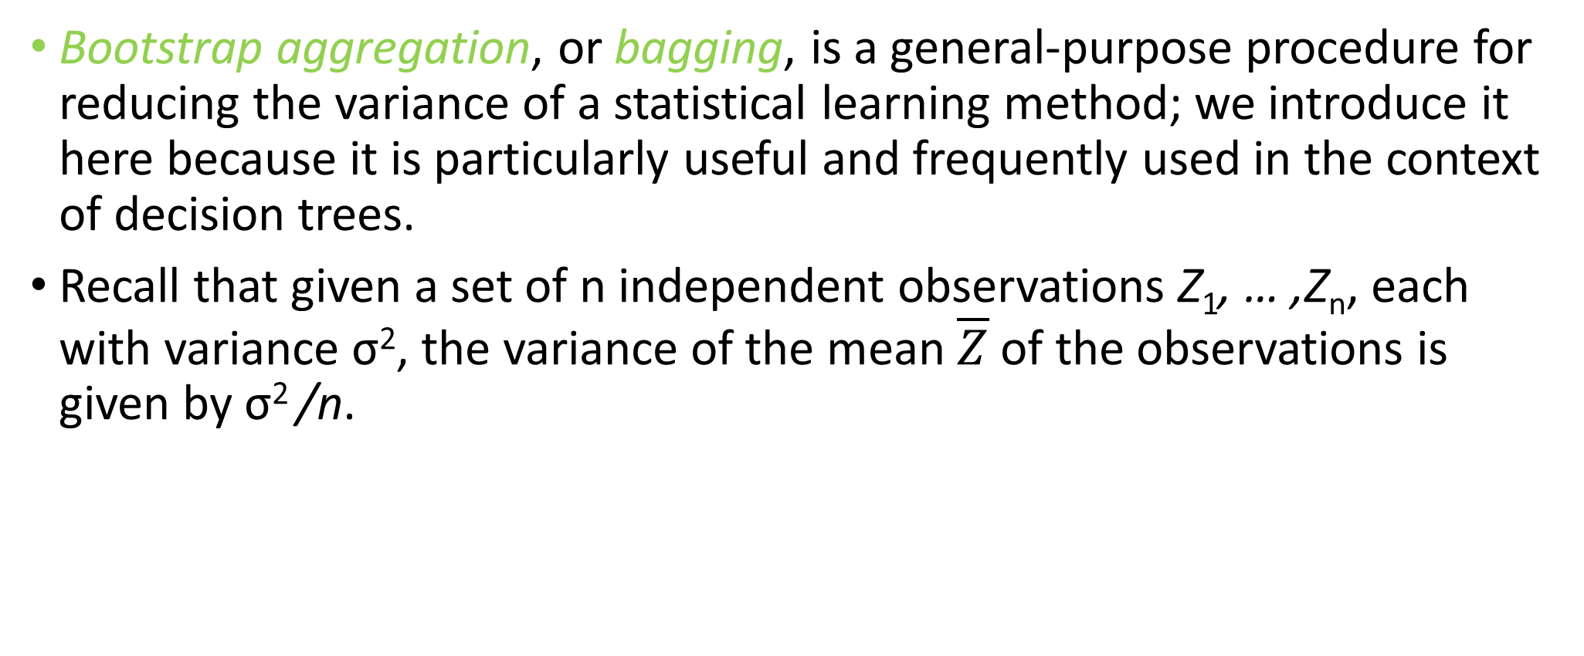
Bagging
Bootstrap aggregation, or bagging, is a general-purpose procedure for reducing the variance of a statistical learning method; we introduce it here because it is particularly useful and frequently used in the context of decision trees.
Recall that given a set of n independent observations Z₁, … ,Z_{n}, each with variance σ², the variance of the mean $\overline{Z}$ of the observations is given by σ² /n.

Slide 33
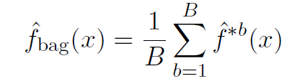
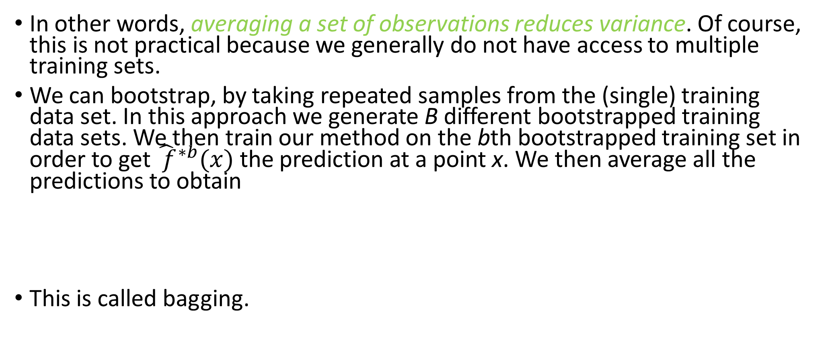
Bagging
In other words, averaging a set of observations reduces variance. Of course, this is not practical because we generally do not have access to multiple training sets.
We can bootstrap, by taking repeated samples from the (single) training data set. In this approach we generate B different bootstrapped training data sets. We then train our method on the bth bootstrapped training set in order to get ${\hat{ f}}^{∗b}(x)$ the prediction at a point x. We then average all the predictions to obtain
This is called bagging.

Slide 34
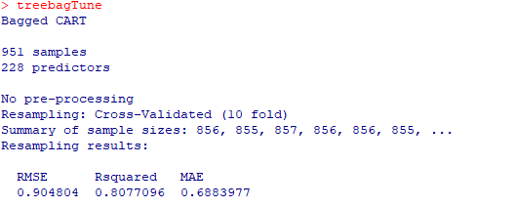
Bagged trees
set.seed(100) treebagTune <- train(x = solTrainXtrans, y = solTrainY, method = "treebag", nbagg = 50, trControl = ctrl) treebagTune

Slide 35
Out-of-bag (OOB) error
The key to bagging is that trees are repeatedly fit to bootstrapped subsets of the observations. On average, each bagged tree makes use of around two-thirds of the observations.

Slide 36
OOB error
The remaining one-third of the observations not used to fit a given bagged tree are referred to as the out-of-bag (OOB) observations.
We can predict the response for the ith observation using each of the trees in which that observation was OOB. This will yield around B/3 predictions for the ith observation, which we average to obtain a single OOB prediction.
An OOB error can computed by averaging the n single OOB predictions.
OOB error is virtually equivalent to LOOCV if B is large.
Bagging improves prediction accuracy at the expense of interpretability!

Slide 37
Boosting
Like bagging, boosting is a general approach that can be applied to many statistical learning methods for regression or classification.
Recall that bagging involves creating multiple copies of the original training data set using the bootstrap, fitting a separate decision tree to each copy, and then combining all of the trees in order to create a single predictive model.
Each tree is built on a bootstrap data set, independent of the other trees.

Slide 38
Boosting
Boosting works in a similar way, except that the trees are grown sequentially and slowly: each tree is grown using information from previously grown trees.
Boosting does not involve bootstrap sampling; instead each tree is fit on a modified version of the original data set.

Slide 39
Bagging vs Boosting
No clear winner; usually depends on the data
Bagging is computationally more efficient than boosting (note that bagging can train the B models in parallel, boosting cannot)

Slide 40
What is the idea behind this procedure?
To avoid potential overfitting of a single tree to the data, the boosting approach learns slowly.
Given the current model, we fit a decision tree to the residuals from the model. We then add this new decision tree into the fitted function in order to update the residuals.
Each of these trees can be rather small, with just a few terminal nodes, determined by the parameter d in the algorithm.
By fitting small trees to the residuals, we slowly improve the model in areas where it does not perform well. The shrinkage parameter λ slows the process down even further, allowing more and different shaped trees to attack the residuals.

Slide 41
Tuning parameters of Boosting
There are three tuning parameters that we must carefully consider
The number of trees K
The shrinkage parameter λ
The number d splits in each tree

Slide 42
The number of trees K
Unlike bagging and random forests, boosting can overfit if K is too large, although this overfitting tends to occur slowly if at all.
We use cross-validation to select K.

Slide 43
The shrinkage parameter λ
The shrinkage parameter λ should be a small positive number.
This controls the rate at which boosting learns.
Typical values are 0.01 or 0.001, and the right choice can depend on the problem.
Very small values can require using a very large value of K in order to achieve good performance.

Slide 44
The number d splits in each tree
The value of d controls the complexity of the boosted ensemble.
Often d = 1 works well, in which case each tree is a stump, consisting of a single split.
More generally d is the interaction depth, and controls the interaction order of the boosted model, since d splits can involve at most d variables.

Slide 45
Boosting
gbmGrid = expand.grid( interaction.depth = seq( 1, 7, by=2 ), n.trees = seq( 100, 1000, by=100 ), shrinkage = c(0.01, 0.1), n.minobsinnode = 10 ) set.seed(100) #takes 463.26 seconds to run in my computer gbmTune <- train(x = solTrainXtrans, y = solTrainY, method = "gbm", tuneGrid = gbmGrid, trControl = ctrl, verbose = FALSE) gbmTune plot(gbmTune, auto.key = list(columns = 4, lines = TRUE)) gbmImp <- varImp(gbmTune, scale = FALSE) gbmImp

Slide 46
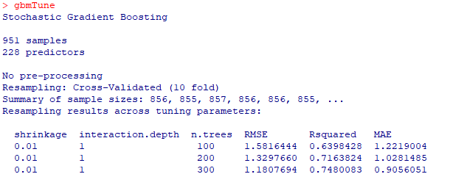
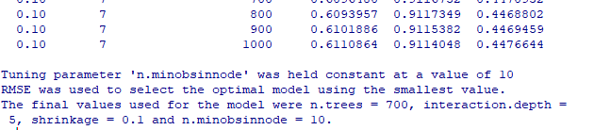
Boosting

Slide 47
Cross-validated RMSE profiles for the boosted tree model

Slide 48
Random forests
Random forests provide an improvement over bagged trees by way of a small tweak that decorrelates the trees. This reduces the variance when we average the trees.
As in bagging, we build a number of decision trees on bootstrapped training samples.
But when building these decision trees, each time a split in a tree is considered, a random selection of m predictors is chosen as split candidates from the full set of p predictors. The split is allowed to use only one of those m predictors.
It usually takes very long time to run and get the output.

Slide 49
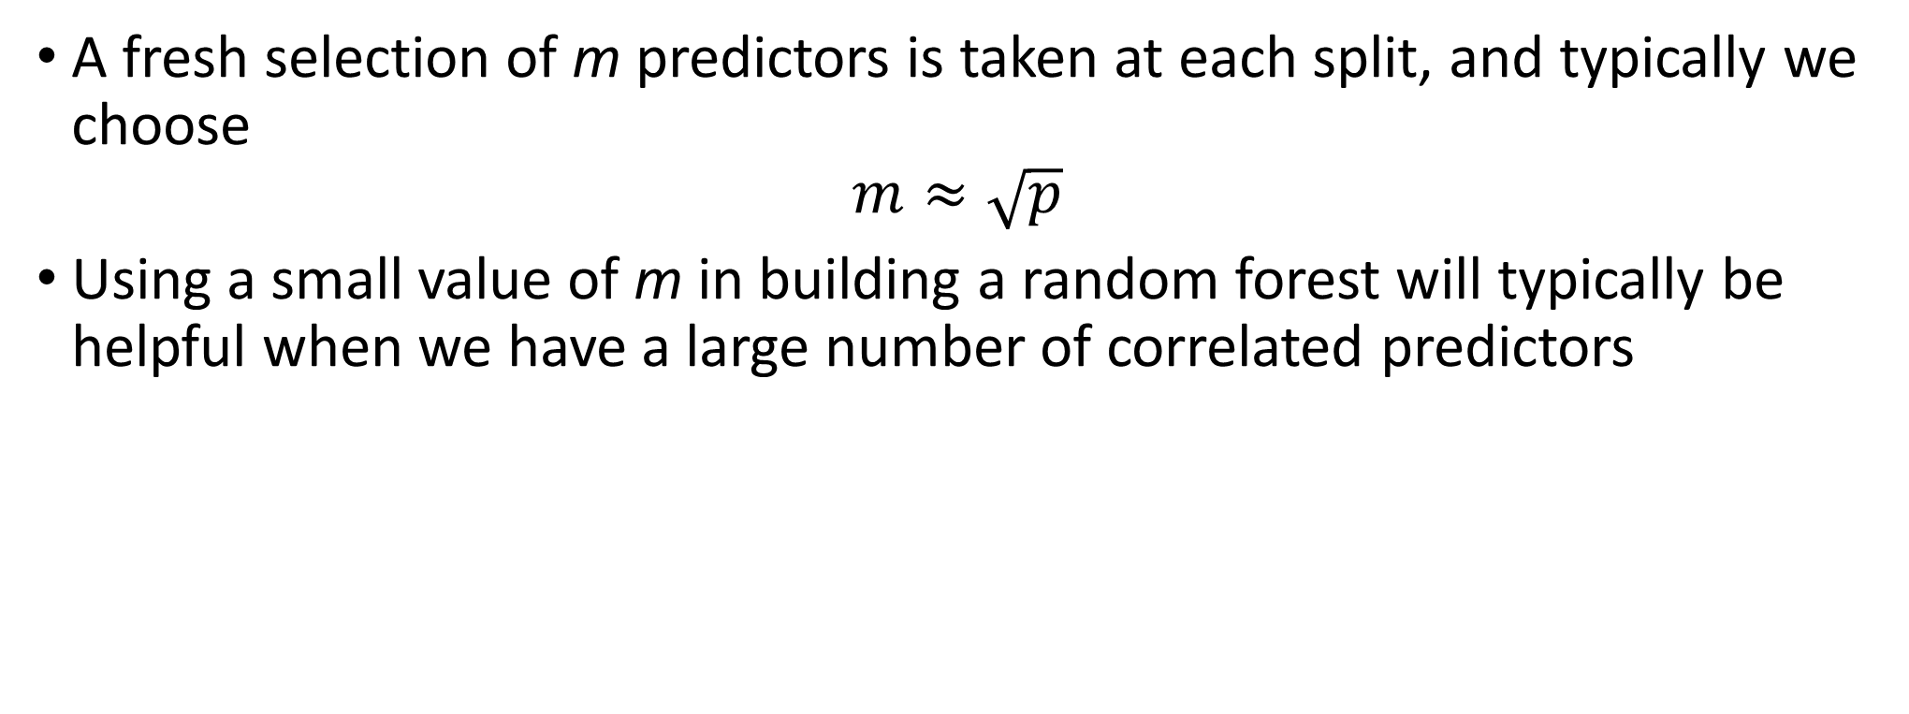
Random forests
A fresh selection of m predictors is taken at each split, and typically we choose
$$m≈\sqrt{p}$$
Using a small value of m in building a random forest will typically be helpful when we have a large number of correlated predictors

Slide 50
Random forests (takes time to run)
mtryGrid <- data.frame(mtry = floor(seq(10, ncol(solTrainXtrans), length = 10))) ### Tune the model using cross-validation set.seed(100) rfTune <- train(x = solTrainXtrans, y = solTrainY, method = "rf", tuneGrid = mtryGrid, ntree = 200, importance = TRUE, trControl = ctrl) rfTune plot(rfTune)

Slide 51
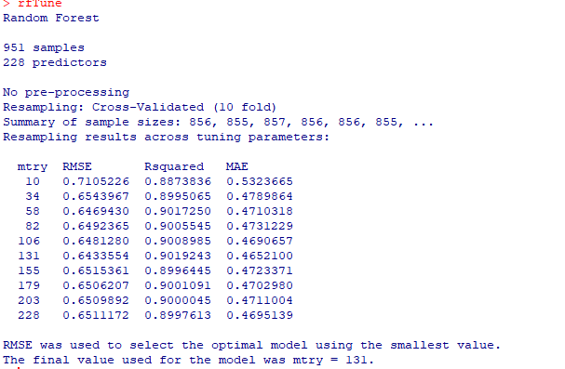
Random forests

Slide 52
Random forests with OOB
### Tune the model using the OOB estimates ctrlOOB <- trainControl(method = "oob") set.seed(100) rfTuneOOB <- train(x = solTrainXtrans, y = solTrainY, method = "rf", tuneGrid = mtryGrid, ntree = 200, importance = TRUE, trControl = ctrlOOB) rfTuneOOB rfImp <- varImp(rfTuneOOB, scale = FALSE) rfImp plot(rfImp, 20)

Slide 53
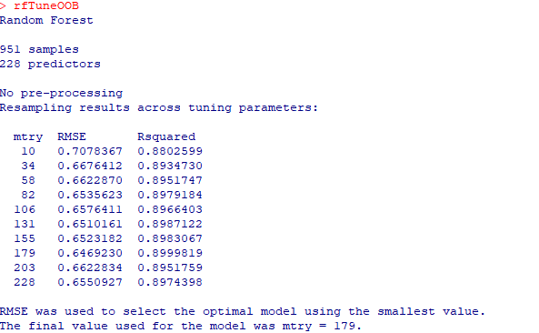
Random forests with OOB

Slide 54
Variable importance

Slide 55
Summary
Decision trees are simple and interpretable models for regression and classification, whereas they are often not competitive with other methods in terms of prediction accuracy
Bagging, random forests and boosting are good methods for improving the prediction accuracy of trees. They work by growing many trees on the training data and then combining the predictions of the resulting ensemble of trees.
The random forests and boosting—are among the state-of-the-art methods for supervised learning. However, their results can be difficult to interpret.

Slide 56
Cubist
Cubist is a rule-based model that is an amalgamation of several methodologies.
Some specific differences between Cubist and the previously described approaches for model trees and their rule-based variants are
The specific techniques used for linear model smoothing, creating rules, and pruning are different
An optional boosting—like procedure called committees
The predictions generated by the model rules can be adjusted using nearby points from the training set data
To tune this model, different numbers of committees and neighbors were assessed.

Slide 57
Cubist
library(Cubist) cbGrid <- expand.grid(committees = c(1:10, 20, 50, 75, 100), neighbors = c(0, 1, 5, 9)) set.seed(100) #takes 307.76 seconds to run in my computer cubistTune <- train(solTrainXtrans, solTrainY, "cubist", tuneGrid = cbGrid, trControl = ctrl) cubistTune plot(cubistTune, auto.key = list(columns = 4, lines = TRUE)) cbImp <- varImp(cubistTune, scale = FALSE) cbImp plot(cblmp, 20)

Slide 58
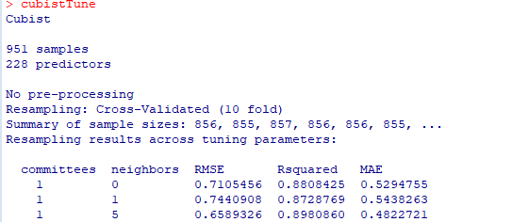
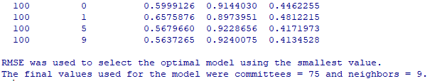
Cubist

Slide 59
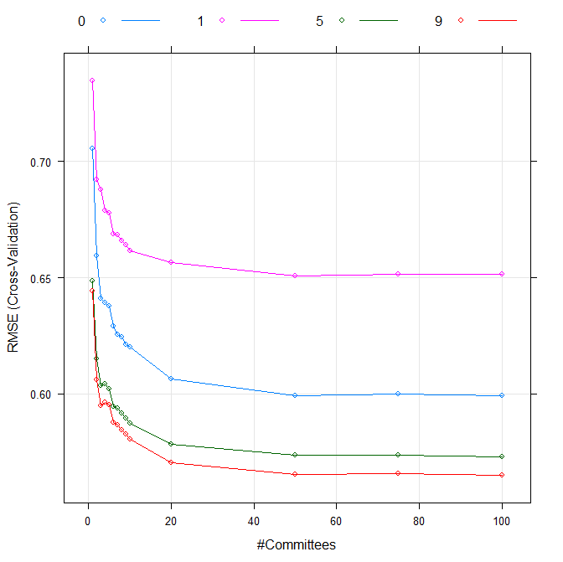
Cubist

Slide 60
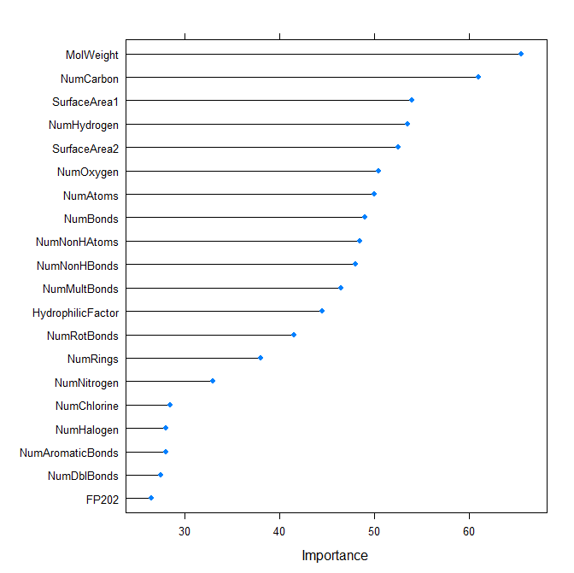
Variable importance

Slide 61
Performance comparison of nonlinear models
### Performance of tree-based models set.seed(100) Cart.pred <- predict(cartTune, solTestXtrans) cTree.pred <- predict(ctreeTune, solTestXtrans) Bagged.pred <- predict(treebagTune, solTestXtrans) Boosting.pred <- predict(gbmTune, solTestXtrans) RF.pred <- predict(rfTune, solTestXtrans) RFOOB.pred <- predict(rfTuneOOB, solTestXtrans) Cubist.pred <- predict(cubistTune, solTestXtrans) data.frame(rbind(CART=postResample(pred=Cart.pred,obs = solTestY), cTree=postResample(pred=cTree.pred ,obs = solTestY), Bagged=postResample(pred=Bagged.pred,obs = solTestY), Boosting=postResample(pred=Boosting.pred,obs = solTestY), RF=postResample(pred=RF.pred,obs = solTestY), RFOOB=postResample(pred=RFOOB.pred,obs = solTestY), Cubist=postResample(pred=Cubist.pred,obs = solTestY) ))

Slide 62
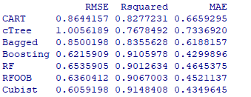

Performance comparison of tree-based models

Slide 63

Introduction to R
Exercise 5

